Slide 1
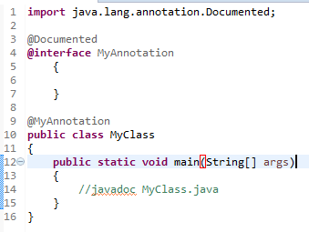
@Documented Annotation
The @Documented annotation is used to signal to the JavaDoc tool that your custom annotation should be visible in the JavaDoc for classes using your custom annotation.
When generating JavaDoc for the MyClass class, the @MyAnnotation is now included in the JavaDoc.
You will not use the @Documented annotation often, but now you know it exists, if you should need it.

